Slide 1

Finding Similar Items: Locality Sensitive Hashing
Modified from CS246: Mining Massive Datasets
Jure Leskovec, Stanford University
http://cs246.stanford.edu

Slide 2
New thread: High dim. data
High dim. data
Locality sensitive hashing
Clustering
Graph data
PageRank, SimRank
Network Analysis
Infinite data
Filtering data streams
Web advertising
Dimensionality reduction
Spam Detection
Queries on streams
Machine learning
SVM
Decision Trees
Perceptron, kNN
Apps
Recommender systems
Association Rules
Duplicate document detection

Slide 3
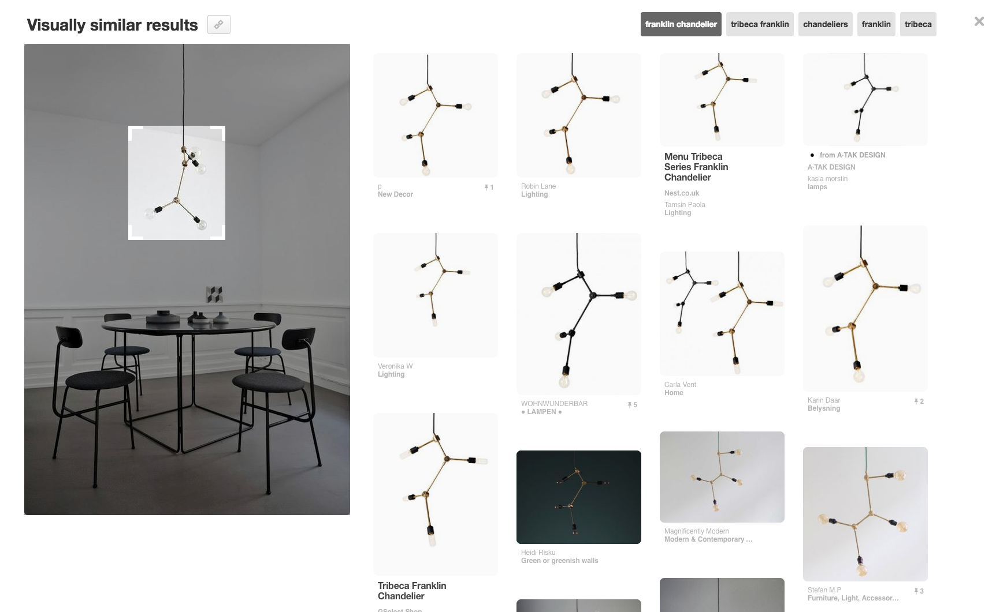
Pinterest Visual Search
Given a query image patch, find similar images
Notes:
… and find visually similar products and recommendations, in real-time
in this particular product, launched last November, you have a cropper tool which you can use to select portions of the image you’re interested in

Slide 4


How does it work?
…
Image Q Feature Vector
…
0
0
1
1
0
1
0
1
0
0
0
0
0
1
1
0
1
0
Hamming
Distance
Similarity (Q, B)
…
Image B Feature Vector
…
1
0
1
0
0
0
0
1
0
1
1
1
0
0
1
0
0
0
Collect billions of images
Determine feature vector for each image (4k dim)
Given a query Q, find nearest neighbors FAST
Notes:
So this is a great, semantically similar items clustering together is a good jump point for visual similarity. Say we have Image A and B, and we’d like to determine a similarity score for the two of them.
We start by running Image A through our network [BUILD] and extracting its intermediate representation, which gives us a feature vector [BUILD].
We can do the same thing for Image B [BUILD], giving us another feature vector. Now, computing image similarity is as simple as taking the Hamming distance [BUILD] between these two feature vectors, where a smaller distance means two images are more similar.

Slide 5
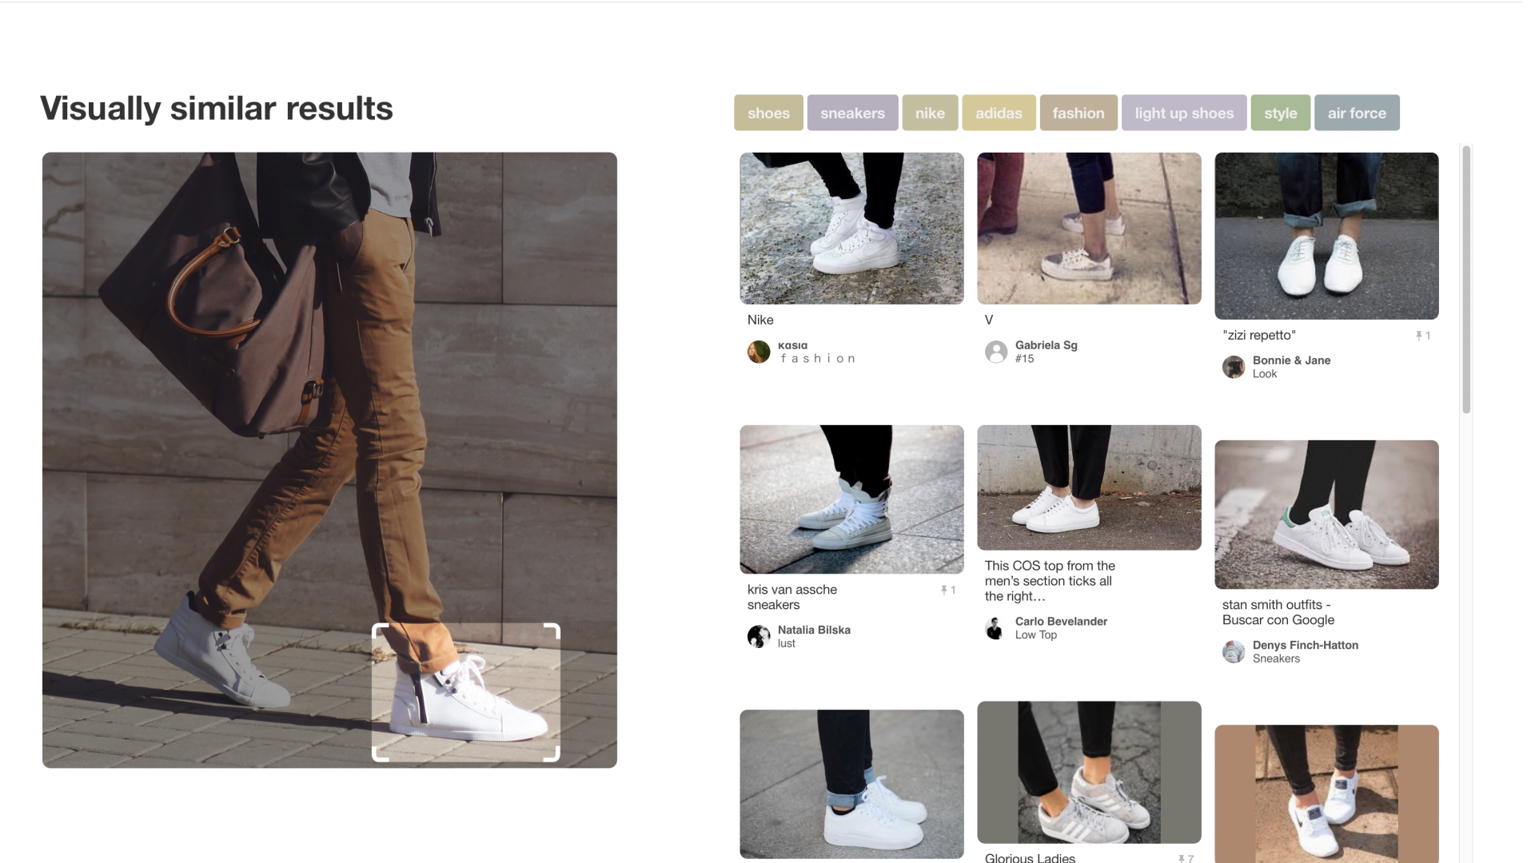
Application: Visual Search
Notes:
Then, after aggregating the labels into a heat map, we can use this as additional training data for our detector models

Slide 6
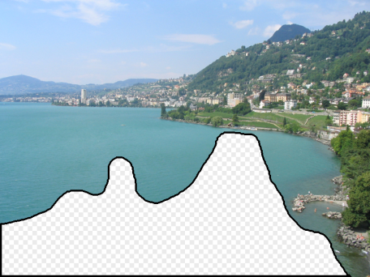
A Common Metaphor
Many problems can be expressed as finding “similar” sets:
Find near-neighbors in high-dimensional space
Examples:
Pages with similar words
For duplicate detection, classification by topic
Customers who purchased similar products
Products with similar customer sets
Images with similar features
Image completion
Recommendations and search

Slide 7
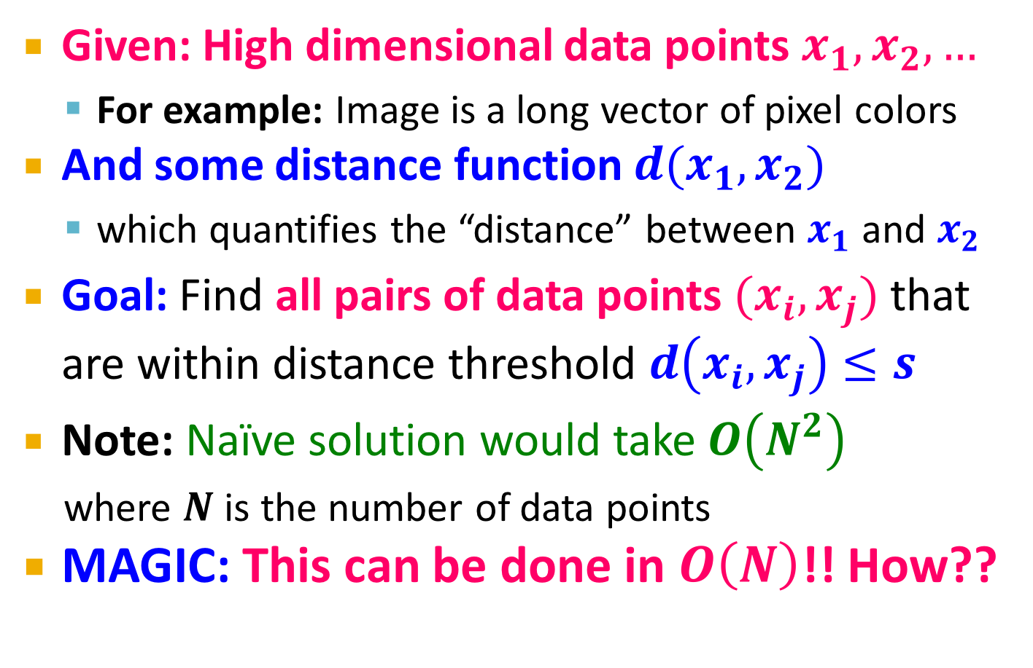
Problem for today’s lecture
Given: High dimensional data points $x_{1}, x_{2}, …$
For example: Image is a long vector of pixel colors
And some distance function $d(x_{1},x_{2})$
which quantifies the “distance” between $x_{1}$ and $x_{2}$
Goal: Find all pairs of data points $(x_{i},x_{j})$ that are within distance threshold $d\left(x_{i},x_{j}\right)≤s$
Note: Naïve solution would take $O\left(N^{2}\right)$
where $N$ is the number of data points
MAGIC: This can be done in $O\left(N\right)$!! How??

Slide 8
LSH: The Bigfoot of CS
LSH is really a family of related techniques
In general, one throws items into buckets using several different “hash functions”
You examine only those pairs of items that share a bucket for at least one of these hashings
Upside: Designed correctly, only a small fraction of pairs are ever examined
Downside: There are false negatives – pairs of similar items that never even get considered

Slide 9
Motivating Application: Finding Similar Documents

Slide 10
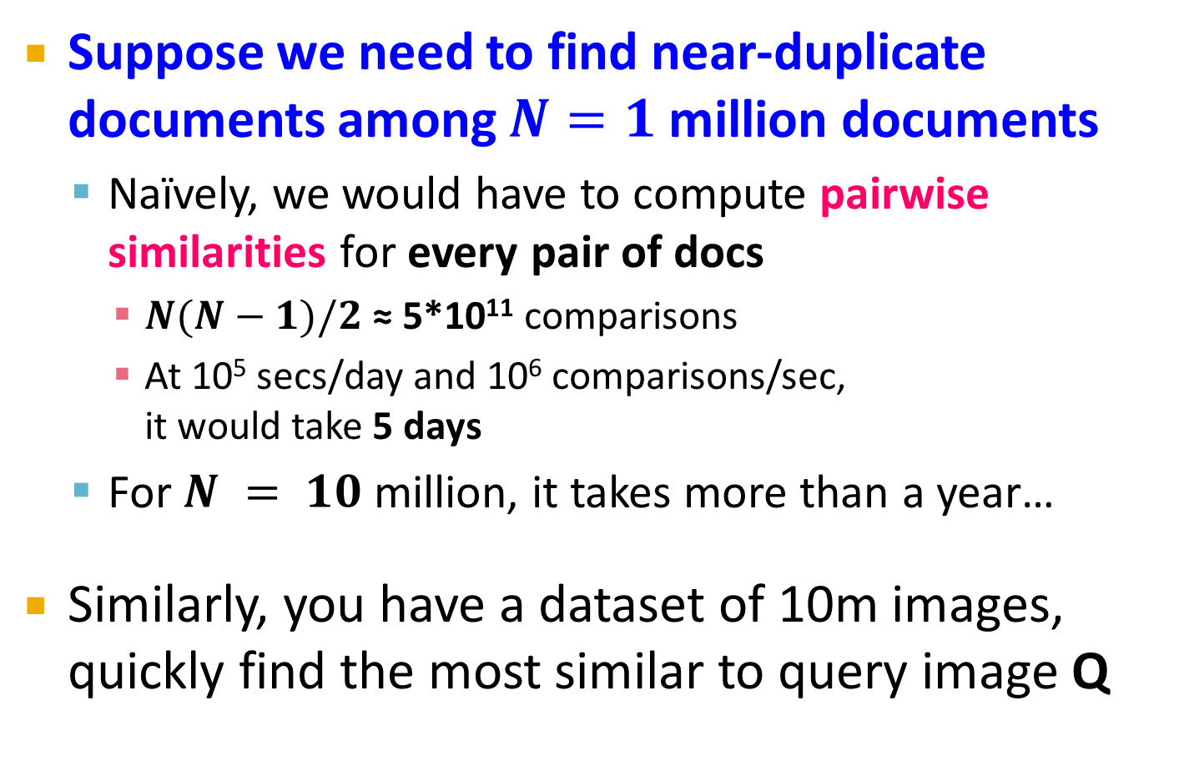
Motivation for Min-Hash/LSH
Suppose we need to find near-duplicate documents among $N=1$ million documents
Naïvely, we would have to compute pairwise similarities for every pair of docs
$N(N−1)/2$ ≈ 5*10¹¹ comparisons
At 10⁵ secs/day and 10⁶ comparisons/sec, it would take 5 days
For $N = 10$ million, it takes more than a year…
Similarly, you have a dataset of 10m images, quickly find the most similar to query image Q

Slide 11
3 Essential Steps for Similar Docs
Shingling: Converts a document into a set representation (Boolean vector)
Min-Hashing: Convert large sets to short signatures, while preserving similarity
Locality-Sensitive Hashing: Focus on pairs of signatures likely to be from similar documents
Candidate pairs!

Slide 12
The Big Picture
Candidate
pairs:
those pairs
of signatures
that we need
to test for
similarity
Shingling
Min Hashing
Locality-
Sensitive
Hashing
Docu-
ment
The set
of strings
of length k
that appear
in the docu-
ment
Signatures:
short integer
vectors that
represent the
sets, and
reflect their
similarity

Slide 13
Shingling
Shingling
Docu-
ment
The set
of strings
of length k
that appear
in the docu-
ment
Step 1: Shingling: Convert a document into a set

Slide 14
Documents as High-Dim Data
Step 1: Shingling: Converts a document into a set
A k-shingle (or k-gram) for a document is a sequence of k tokens that appears in the doc
Tokens can be characters, words or something else, depending on the application
Assume tokens = characters for examples
To compress long shingles, we can hash them to (say) 4 bytes
Represent a document by the set of hash values of its k-shingles

Slide 15
Compressing Shingles
Example: k=2; document D₁= abcab Set of 2-shingles: S(D₁) = {ab, bc, ca} Hash the shingles: h(D₁) = {1, 5, 7}
k = 8, 9, or 10 is often used in practice
Benefits of shingles:
Documents that are intuitively similar will have many shingles in common
Changing a word only affects k-shingles within distance k-1 from the word

Slide 16
Similarity Metric for Shingles
Document D₁ is a set of its k-shingles C₁=S(D₁)
A natural similarity measure is the Jaccard similarity:
sim(D₁, D₂) = |C₁∩C₂|/|C₁∪C₂|
Jaccard distance: d(C₁, C₂) = 1 - |C₁∩C₂|/|C₁∪C₂|
3 in intersection.
8 in union.
Jaccard similarity
= 3/8

Slide 17
From Sets to Boolean Matrices
Encode sets using 0/1 (bit, Boolean) vectors
Rows = elements (shingles)
Columns = sets (documents)
1 in row e and column s if and only if e is a member of s
Column similarity is the Jaccard similarity of the corresponding sets (rows with value 1)
Typical matrix is sparse!
Each document is a column:
Example: sim(C₁ ,C₂) = ?
Size of intersection = 3; size of union = 6, Jaccard similarity (not distance) = 3/6
d(C₁,C₂) = 1 – (Jaccard similarity) = 3/6
Documents
1
1
1
0
1
1
0
1
0
1
0
1
0
0
0
1
Shingles
1
0
0
1
1
1
1
0
1
0
1
0
We don’t really construct the matrix; just imagine it exists

Slide 18
Outline: Finding Similar Columns
So far:
Documents → Sets of shingles
Represent sets as boolean vectors in a matrix
Next goal: Find similar columns while computing small signatures
Similarity of columns == similarity of signatures
Warnings:
Comparing all pairs takes too much time: Job for LSH
These methods can produce false negatives, and even false positives (if the optional check is not made)

Slide 19
Min-Hashing
Shingling
Min-Hash-
ing
Docu-
ment
The set
of strings
of length k
that appear
in the doc-
ument
Signatures:
short integer
vectors that
represent the
sets, and
reflect their
similarity
Step 2: Min-Hashing: Convert large sets to short signatures, while preserving similarity

Slide 20
Hashing Columns (Signatures)
Key idea: “hash” each column C to a small signature h(C), such that:
sim(C₁, C₂) is the same as the “similarity” of signatures h(C₁) and h(C₂)
Goal: Find a hash function h(·) such that:
If sim(C₁,C₂) is high, then with high prob. h(C₁) = h(C₂)
If sim(C₁,C₂) is low, then with high prob. h(C₁) ≠ h(C₂)
Idea: Hash docs into buckets. Expect that “most” pairs of near duplicate docs hash into the same bucket!

Slide 21
Min-Hashing: Goal
Goal: Find a hash function h(·) such that:
if sim(C₁,C₂) is high, then with high prob. h(C₁) = h(C₂)
if sim(C₁,C₂) is low, then with high prob. h(C₁) ≠ h(C₂)
Clearly, the hash function depends on the similarity metric:
Not all similarity metrics have a suitable hash function
There is a suitable hash function for the Jaccard similarity: It is called Min-Hashing

Slide 22
Min-Hashing: Overview
Permute the rows of the Boolean matrix
Thought experiment – not real
Define minhash function for this permutation, h(C) = the number of the first (in the permuted order) row in which column C has 1:
h_{π} (C) = min_{π} π(C)
Apply, to all columns, several randomly chosen permutations to create a signature for each column
Result is a signature matrix: columns = sets, rows = minhash values, in order for that column
Notes:
We are now going to define minhashing.
Click 1
Each minhashing hash function is associated with a permutation of the rows of the matrix. We don’t physically permute the rows; that would take much too much time. We just imagine the rows are permuted.
Click 2
The definition of the minhash function h associated with a permutation is that h of a column C is the number of the first row, in the permuted order, in which that column has a 1.
Click 3
To create the signature for each of the columns of a matrix, we pick some number – about 100 is often a good choice – of permutations and use their associated minhash functions, say h1 through h100. For each column, the signature is the sequence of row numbers we get when we apply each of these minhash functions in turn to the column.
It is important to remember that, for the entire matrix or collection of sets, we select the minhash functions once and apply the same minhash functions, to each of the columns.
Click 4
We can think of the signatures as another matrix. The columns of the signature matrix correspond to the columns of the original matrix, that is, to the sets in the collection. Each row of the signature matrix is the result of applying one of the chosen minhash functions to each of the columns.

Slide 23
Min-Hashing
Imagine the rows of the boolean matrix permuted under random permutation π
Define a “hash” function h_{π}(C) = the number of the first (in the permuted order π) row in which column C has value 1:
h_{π} (C) = min_{π} π(C)
Use several (e.g., 100) independent hash functions (that is, permutations) to create a signature of a column

Slide 24
Min-Hashing Example
2nd element of the permutation (row 1) is the first to map to a 1
Permutation π
Input matrix (Shingles x Documents)
Signature matrix M
2
4
3
4
7
2
6
1
5
1
0
1
0
2
1
2
1
3
2
1
0
0
1
2
1
4
1
7
1
0
1
0
1
1
2
1
2
6
3
0
1
0
1
1
6
0
1
0
1
h₂(3)=1 (permutation 2, column 3) 4th element of the permutation (row 1) is the first to map to a 1
5
7
1
0
1
0
4
5
1
0
1
0

Slide 25
A Subtle Point
Students sometimes ask whether the minhash value should be the original number of the row, or the number in the permuted order (as we did in our example).
Answer: it doesn’t matter
You only need to be consistent, and assure that two columns get the same value if and only if their first 1’s in the permuted order are in the same row

Slide 26
The Min-Hash Property
0
0
0
0
1
1
Choose a random permutation π
Claim: Pr[h_{π}(C₁) = h_{π}(C₂)] = sim(C₁, C₂)
Why?
Let X be a doc (set of shingles), z∈ X is a shingle
Then: Pr[π(z) = min(π(X))] = 1/|X|
It is equally likely that any z∈ X is mapped to the min element
Let y be s.t. π(y) = min(π(C₁∪C₂))
Then either: π(y) = min(π(C₁)) if y ∈ C₁ , or
π(y) = min(π(C₂)) if y ∈ C₂
So the prob. that both are true is the prob. y ∈ C₁ ∩ C₂
Pr[min(π(C₁))=min(π(C₂))]=|C₁∩C₂|/|C₁∪C₂|= sim(C₁, C₂)
0
0
0
1
1
0
One of the two cols had to have 1 at position y
Notes:
Size of the universe of all possible vals of min(π(C₁∪C₂)) is |C₁∪C₂| and in |C₁∩C₂| of cases it can be that min(π(C₁))=min(π(C₂)) which exactly the jaccard between C1 and C2
For two columns A and B, we have h_π(A) = h_π(B) exactly when the minimum hash value of the union A ∪ B lies in the intersection A ∩ B. Thus Pr[h_π(A) = h_π(B)] = |A ∩ B| / |A ∪ B|.

Slide 27
Four Types of Rows
0
0
0
0
1
1
Given cols C₁ and C₂, rows are classified as:
C₁ C₂
A 1 1
B 1 0
C 0 1
D 0 0
Define: a = # rows of type A, etc.
Note: sim(C₁, C₂) = a/(a +b +c)
Then: Pr[h(C₁) = h(C₂)] = Sim(C₁, C₂)
Look down the permuted cols C₁ and C₂ until we see a 1
If it’s a type-A row, then h(C₁) = h(C₂) If a type-B or type-C row, then not
0
0
0
1
1
0

Slide 28
Similarity for Signatures
We know: Pr[h_{π}(C₁) = h_{π}(C₂)] = sim(C₁, C₂)
Now generalize to multiple hash functions
The similarity of two signatures is the fraction of the hash functions in which they agree
Thus, the expected similarity of two signatures equals the Jaccard similarity of the columns or sets that the signatures represent.
And the longer the signatures, the smaller will be the expected error.
Notes:
Each agress with prob s.
So to estimate s we compute what fraction of hash functions agree

Slide 29
Min-Hashing Example
Permutation π
Input matrix (Shingles x Documents)
Signature matrix M
2
4
3
4
7
2
6
1
5
1
0
1
0
2
1
2
1
3
2
1
0
0
1
2
1
4
1
7
1
0
1
0
1
1
2
1
2
6
3
0
1
0
1
1
6
0
1
0
1
Similarities:
1-3 2-4 1-2 3-4
Col/Col 0.75 0.75 0 0
Sig/Sig 0.67 1.00 0 0
5
7
1
0
1
0
4
5
1
0
1
0

Slide 30
Implementation Trick
Permuting rows even once is prohibitive
Row hashing!
Pick K = 100 hash functions h_{i}
Ordering under h_{i} gives a random permutation of rows!
One-pass implementation
For each column c and hash-func. h_{i} keep a “slot” M(i, c) for the min-hash value
Initialize all M(i, c) = ∞
Scan rows looking for 1s
Suppose row j has 1 in column c
Then for each h_{i} :
If h_{i}(j) < M(i, c), then M(i, c) ← h_{i}(j)
How to pick a random hash function h(x)?
Universal hashing:
h_{a,b}(x)=((a·x+b) mod p) mod N
where:
a,b … random integers
p … prime number (p > N)

Slide 31
Implementation
for each row r do begin
for each hash function h_{i} do
compute h_{i} (r);
for each column c
if c has 1 in row r
for each hash function h_{i} do
if h_{i} (r) < M(i, c) then
M(i, c) := h_{i} (r);
end;
Important: so you hash r only
once per hash function, not
once per 1 in row r.
Notes:
Here’s the algorithm in a nutshell. The outer loop is on the rows (POINT). For each row r, the first thing we do is compute each of the perhaps 100 hash values h_i(r) (POINT). Then we loop over all the columns c (POINT). If column c does not have a 1 in row r, then we do nothing for r and c.
But suppose matrix M has 1 in row r and column c (POINT). Then we loop over the index i for all the hash functions (POINT). For each of these perhaps 100 values of i, we check whether h_i(r) is smaller than the smallest value currently in the slot for hash function i and column c (POINT). If so, we replace that slot by h_i(r).
We take M(i,c) to be infinity initially, so the first row we find that has a 1 in column c surely is placed in that slot. Also note that it is important we compute h_i(r) only once for each hash function and each row, outside the loop over columns.

Slide 32
Example Implementation
M(i, C₁) M(i, C₂)
h(1) = 1 1 ∞
g(1) = 3 3 ∞
Row C₁ C₂
1 1 0
2 0 1
3 1 1
4 1 0
5 0 1
h(2) = 2 1 2
g(2) = 0 3 0
h(3) = 3 1 2
g(3) = 2 2 0
h(4) = 4 1 2
g(4) = 4 2 0
h(x) = x mod 5
g(x) = (2x+1) mod 5
h(5) = 0 1 0
g(5) = 1 2 0
Signature matrix M
Notes:
Let’s do a little example. Our matrix has only two columns and five rows (POINT). We’re going to use only two hash functions; that is, we compute signatures of length 2. The two hash functions we use are shown here (POINT). Each maps integers to five buckets. The first, which we call h(x), maps any integer x to x modulo 5, that is, the remainder when x is divided by 5 (POINT). The second, g(x) (POINT), maps x to 2x+1 modulo 5.
We are ready to compute the two components of the signatures for each of these columns. Remember that initially, we assume all slots are infinity. Begin by looking at the first row (POINT). We find h(1) = 1, and g(1) = 3 modulo 5, or 3. Row 1 has 1 in the first column, but 0 in the second. Therefore, the second signature is not changed and both its components remain at infinity (POINT). But the first signature is changed to the values of h(1) and g(1), that is, 1 and 3 (POINT).
Click 1
Now consider the second row. h(2) = 2, and g(2) = 5 modulo 5 = 0. Since column 1 has 0 in the second row, we do not change its signature. But column 2 has 1 in row 2, so we replace the infinite values in its signature by 2 and 0 (POINT).
Click 2
Next, the third row. h(3) = 3 and g(3) = 7 modulo 5, or 2. There is 1 in row 3 of both columns, so both signatures are candidates for being lowered. However, h(3) is 3, and the first components of both signatures are already lower, 1 and 2, respectively (POINT). So we do not change either first component. g(3) is 2, so we might change either second component. For the first signature, the current value is 3 (POINT), so we lower it to 2 (POINT). But for the second signature, the current value, 0 (POINT) is already lower than 2, so we leave it at 0.
Click 3
h(4) = 4, and g(4) = 9 modulo 5, or 4. Since 4 is larger than any of the current slots for the first column, no changes are made.
Click 4
Finally, h(5) = 5 modulo 5, or 0, and g(5) = 11 modulo 5, or 1. Only the second column has a 1 in row 5, so we can only change its signature. Since h(5) = 0, and the old value of the slot for h is 2 (POINT), we lower it to 0. But the slot for g already has 0, which is lower than g(5), or 1, so no change is made there (POINT). Thus, the final signatures are (1,2) for the first column (POINT) and (0,0) for the second column (POINT).
Incidentally, notice that the two signatures disagree for both components, so they estimate the Jaccard similarity of the columns to be 0. That’s off by a little, since as you can see, the true Jaccard similarity of the columns is 1/5.

Slide 33
Locality Sensitive Hashing
Candidate
pairs:
those pairs
of signatures
that we need
to test for
similarity
Shingling
Min-Hash-
ing
Locality-
Sensitive
Hashing
Docu-
ment
The set
of strings
of length k
that appear
in the doc-
ument
Signatures:
short integer
vectors that
represent the
sets, and
reflect their
similarity
Step 3: Locality Sensitive Hashing: Focus on pairs of signatures likely to be from similar documents

Slide 34
LSH: Overview
2
1
4
1
1
2
1
2
2
1
2
1
Goal: Find documents with Jaccard similarity at least s (for some similarity threshold, e.g., s=0.8)
LSH – General idea: Use a hash function that tells whether x and y is a candidate pair: a pair of elements whose similarity must be evaluated
For Min-Hash matrices:
Hash columns of signature matrix M to many buckets
Each pair of documents that hashes into the same bucket is a candidate pair

Slide 35
LSH: Overview
2
1
4
1
1
2
1
2
2
1
2
1
Pick a similarity threshold s (0 < s < 1)
Columns x and y of M are a candidate pair if their signatures agree on at least fraction s of their rows: M (i, x) = M (i, y) for at least frac. s values of i
We expect documents x and y to have the same (Jaccard) similarity as their signatures

Slide 36
LSH for Min-Hash
2
1
4
1
1
2
1
2
2
1
2
1
Big idea: Hash columns of signature matrix M several times
Arrange that (only) similar columns are likely to hash to the same bucket, with high probability
Candidate pairs are those that hash to the same bucket

Slide 37
Partition M into b Bands
2
1
4
1
1
2
1
2
2
1
2
1
r rows
per band
b bands
One
signature
Signature matrix M

Slide 38
Partition M into Bands
Divide matrix M into b bands of r rows
For each band, hash its portion of each column to a hash table with k buckets
Make k as large as possible
Candidate column pairs are those that hash to the same bucket for ≥ 1 band
Tune b and r to catch most similar pairs, but few non-similar pairs

Slide 39
Hashing Bands
Buckets
Columns 2 and 6
are probably identical
(candidate pair)
Columns 6 and 7 are
surely different.
Matrix M
r rows
b bands

Slide 40
Hashing Bands
Buckets
Columns 2 and 6
are probably identical
(candidate pair)
Columns 6 and 7 are
surely different.
Matrix M
r rows
b bands

Slide 41
Simplifying Assumption
There are enough buckets that columns are unlikely to hash to the same bucket unless they are identical in a particular band
Hereafter, we assume that “same bucket” means “identical in that band”
Assumption needed only to simplify analysis, not for correctness of algorithm

Slide 42
Example of Bands
2
1
4
1
1
2
1
2
2
1
2
1
Assume the following case:
Suppose 100,000 columns of M (100k docs)
Signatures of 100 integers (rows)
Therefore, signatures take 40MB
Goal: Find pairs of documents that are at least s = 0.8 similar
Choose b = 20 bands of r = 5 integers/band

Slide 43
C₁, C₂ are 80% Similar
2
1
4
1
1
2
1
2
2
1
2
1
Find pairs of ≥ s=0.8 similarity, set b=20, r=5
Assume: sim(C₁, C₂) = 0.8
Since sim(C₁, C₂) ≥ s, we want C₁, C₂ to be a candidate pair: We want them to hash to at least 1 common bucket (at least one band is identical)
Probability C₁, C₂ identical in one particular band: (0.8)⁵ = 0.328
Probability C₁, C₂ are not similar in all of the 20 bands: (1-0.328)²⁰ = 0.00035
i.e., about 1/3000th of the 80%-similar column pairs are false negatives (we miss them)
We would find 99.965% pairs of truly similar documents

Slide 44
C₁, C₂ are 30% Similar
2
1
4
1
1
2
1
2
2
1
2
1
Find pairs of ≥ s=0.8 similarity, set b=20, r=5
Assume: sim(C₁, C₂) = 0.3
Since sim(C₁, C₂) < s we want C₁, C₂ to hash to NO common buckets (all bands should be different)
Probability C₁, C₂ identical in one particular band: (0.3)⁵ = 0.00243
Probability C₁, C₂ identical in at least 1 of 20 bands: 1 - (1 - 0.00243)²⁰ = 0.0474
In other words, approximately 4.74% pairs of docs with similarity 0.3 end up becoming candidate pairs
They are false positives since we will have to examine them (they are candidate pairs) but then it will turn out their similarity is below threshold s

Slide 45
LSH Involves a Tradeoff
2
1
4
1
1
2
1
2
2
1
2
1
Pick:
The number of Min-Hashes (rows of M)
The number of bands b, and
The number of rows r per band
to balance false positives/negatives
Example: If we had only 10 bands of 10 rows, the number of false positives would go down, but the number of false negatives would go up

Slide 46
Analysis of LSH – What We Want
Probability = 1 if t > s
Probability
of sharing
a bucket
No chance
if t < s
Say “yes” if you
are below the line.
Similarity threshold s
Similarity t =sim(C₁, C₂) of two sets

Slide 47
What 1 Band of 1 Row Gives You
Probability
of sharing
a bucket
Remember:
Probability of
equal hash-values
= similarity
Similarity t =sim(C₁, C₂) of two sets

Slide 48
What 1 Band of 1 Row Gives You
False
negatives
Probability
of sharing
a bucket
Say “yes” if you
are below the line.
False
positives
s
Similarity t =sim(C₁, C₂) of two sets

Slide 49
b bands, r rows/band
Say columns C₁ and C₂ have similarity t
Pick any band (r rows)
Prob. that all rows in band equal = t^{r}
Prob. that some row in band unequal = 1 - t^{r}
Prob. that no band identical = (1 - t^{r})^{b}
Prob. that at least 1 band identical = 1 - (1 - t^{r})^{b}

Slide 50
What b Bands of r Rows Gives You
No bands
identical
At least
one band
identical
(
)^{b}
Probability
of sharing
a bucket
1 -
1 -
t ^{r}
All rows
of a band
are equal
Some row
of a band
unequal
Similarity t=sim(C₁, C₂) of two sets

Slide 51
Example: b = 20; r = 5
Similarity threshold s
Prob. that at least 1 band is identical:
s | 1-(1-s^{r})^{b}
0.2 | 0.006
0.3 | 0.047
0.4 | 0.186
0.5 | 0.470
0.6 | 0.802
0.7 | 0.975
0.8 | 0.9996

Slide 52
Picking r and b: The S-curve
Picking r and b to get the best S-curve
50 hash-functions (r=5, b=10)
Prob. sharing a bucket
Blue area: False Negative rate
Green area: False Positive rate
Similarity

Slide 53
LSH Summary
Tune M, b, r to get almost all pairs with similar signatures, but eliminate most pairs that do not have similar signatures
Check in main memory that candidate pairs really do have similar signatures
Optional: In another pass through data, check that the remaining candidate pairs really represent similar documents

Slide 54
Summary: 3 Steps
Shingling: Convert documents to set representation
We used hashing to assign each shingle an ID
Min-Hashing: Convert large sets to short signatures, while preserving similarity
We used similarity preserving hashing to generate signatures with property Pr[h_{π}(C₁) = h_{π}(C₂)] = sim(C₁, C₂)
We used hashing to get around generating random permutations
Locality-Sensitive Hashing: Focus on pairs of signatures likely to be from similar documents
We used hashing to find candidate pairs of similarity ≥ s

